Slide 1

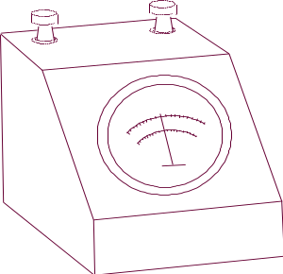



Chapter 7
Physical Reliability
Covariate Models
Static & Dynamic Models
Physics of Failure Models
Chapter 7
Notes:
Until now, we have defined reliability, R(t), to be only a function of time. While it is true that components are observed failing over time, components also fail as a result of the stresses placed upon them. These stresses may be continuous leading to a gradual degradation in performance or they may occur at discrete points in time. Discrete occurrences may be periodic, random, or simply a one-time event. A single point-in-time stress may or may not result in a failure depending upon whether the stress exceeds the design strength of the component or not. This chapter looks at several models that in some manner addresses the physical nature of the failure process.

Slide 2
Basic Premise of Chapter 7
Factors other than time alone influence failures
  Factors may include external stresses and forces such as heat, pressure, contamination, vibration, and power surges.
  Factors may also include internal design characteristics such as strength of material, geometry, and operating use.
  Factors may also include the manufacturing environment such as production lot, manufacturing specs, quality control criteria, day of the week, and shift.
Individual units will differ among these factors
Chapter 7

Slide 3
Covariate Models
One or more of the failure distribution parameters is a function of explanatory or covariate variables
Usually a physical cause and effect
  If cause and effect exist, then can use covariates to control reliability
  Otherwise, can only use covariates to predict reliability.
  Use design of experiments to establish cause and effect
Chapter 7
Notes:
We begin with covariate models. Covariate models define at least one of the parameters of the failure distribution as a function of one or more stresses placed upon the component. Determining a suitable relationship between a parameter and the stresses placed upon a component is discussed in Part II of the text. Multiple and nonlinear regression analysis can be used to estimate the function f(x₁,…,x_{n}) shown above. Typically the distribution parameter is a scale or location parameter such as mean or characteristic life.

Slide 4
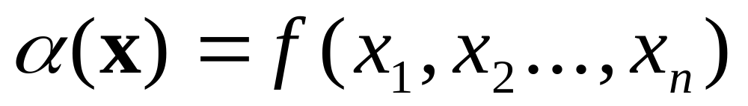
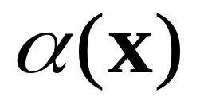
General Covariate Model
may be a mean, median, percentile, etc.
and the x_{i} may be a stress such as voltage, temperature
pressure, or humidity.
Chapter 7

Slide 5
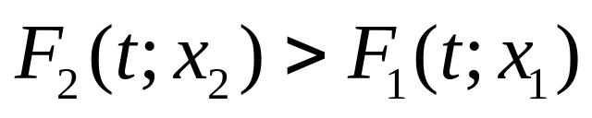
The Effect of Stress
If x₁ and x₂ are two stress levels where x₂ > x₁,
then for all positive values of t,
A more severe stress accelerates the time to failure.
Chapter 7

Slide 6
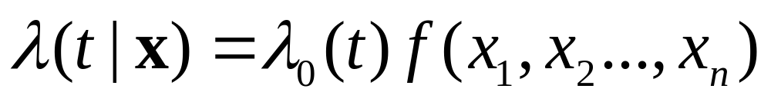
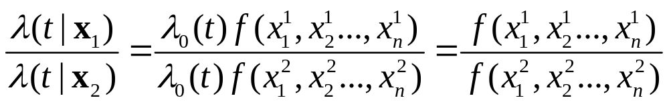
Proportional Hazards Models
Has the property that individual component hazard rate functions are proportional to each other.
Not a function of time; therefore can extrapolate in stress
without regard to time.
Chapter 7

Slide 7
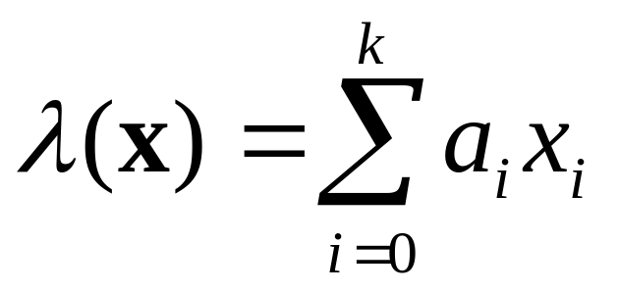
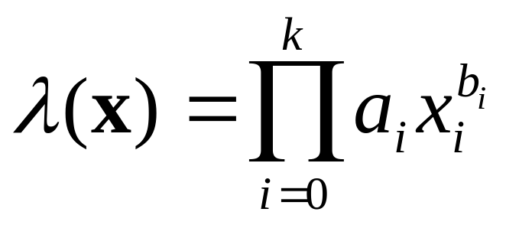
Exponential Distribution
Has a proportional hazard rate since λ(t) is a constant and λ₀(t) =1
linear model:
where the a_{i} are unknown parameters to be estimated
and x₀ =1.
multiplicative model:
Chapter 7
Notes:
The simplest relationship that can be assumed between a parameter and a set of stress variables is a linear one. However, the multiplicative model also shown above may be preferred over the linear model. For example, it often fits the data better than the linear model.

Slide 8
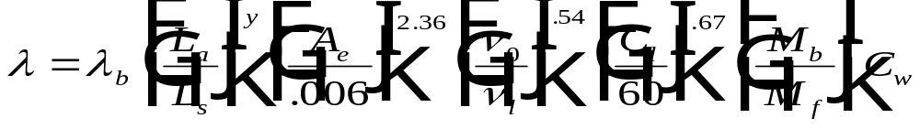
Example – Exponential Multiplicative Model
Failure rate of ball bearings:
b = base failure rate of a bearing per 10⁶ hours of operation
L_{a} = actual radial load in pounds
L_{s} = specification radial load in pounds
y = 3.33 for roller bearings; 3.0 for ball bearings
A_{e} = alignment error in radians
v₀ = specification lubricant viscosity (lb-min/in2)
v_{l} = operating lubricant viscosity (lb-min/in2)
C_{l} = actual contamination level in micrograms/meter3
M_{b} = material factor, base material in PSI (yield strength)
M_{f} = material factor, operating material in PSI (yield strength)
C_{w} = water contamination factor (leakage of water into the oil lubricant)
Chapter 7
Notes:
An example of a multiplicative model is shown here. Lambda sub-b is a base failure rate that is observed when all of the stress variables are at ”nominal” values. Nominal values are those values for which the corresponding factor equals one (1).

Slide 9
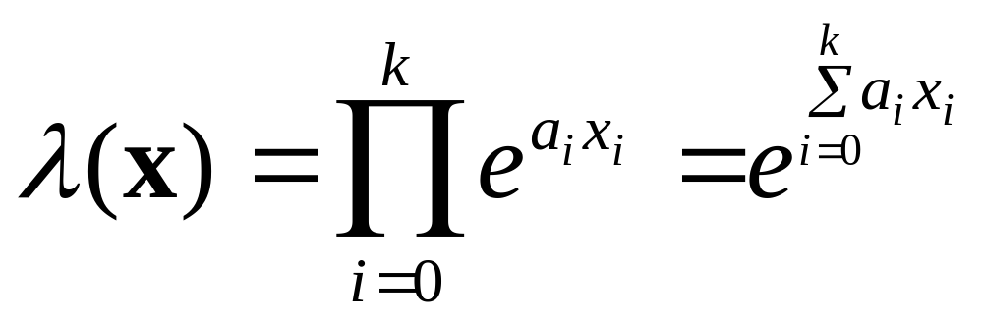
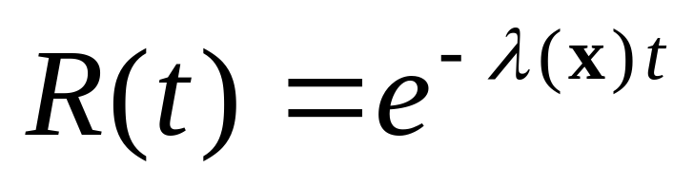
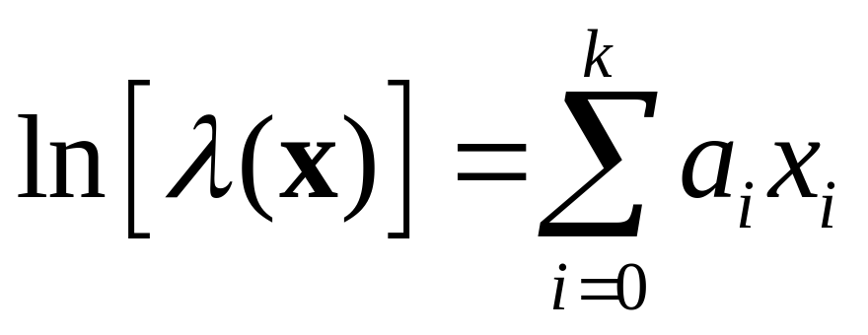
Exponential Multiplicative Model
Use multiple
linear regression
to estimate the a_{i}
Chapter 7
Notes:
To apply the multiplicative model to the exponential failure distribution, the failure rate is assumed to be equal to the expression shown above where the x_{i} are covariates and the a_{i} are coefficients to be estimated. This form of the multiplicative model has the advantage that it is always positive even if some of the a_{i} are negative. It is also linear in the logarithm of lambda-x which allows for parameter estimation using least-squares.

Slide 10
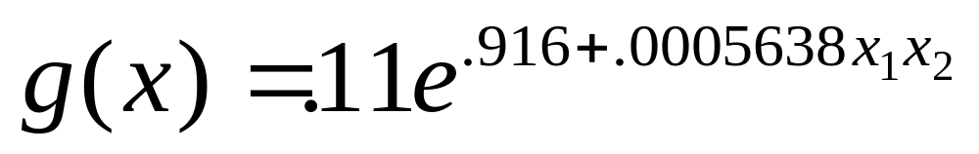
Example - Exponential Multiplicative Model
From MILHDBK 217: monolithic microelectronic device:
where x₁ = operating voltage
x₂ = worst-case junction temperature
Chapter 7
Notes:
In this example, there are two covariates – voltage and temperature.

Slide 11
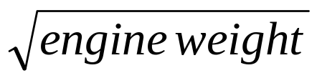
Example - Parametric Model
MTBM = 34.104 + .0009853 x engine weight
- .31223
where MTBM = mean time (flying hours)
between maintenance of an aircraft engine.
Chapter 7
Notes:
A common approach is to use regression (least-square) analysis to establish a more general relationship between a distribution parameter such as the mean or median and one or more independent variables. In the example shown, engine weight is perhaps a surrogate for the complexity of the engine or the magnitude of the forces acting upon the engine. As complexity and stress levels increase, it is expected that time between failures would decrease.

Slide 12
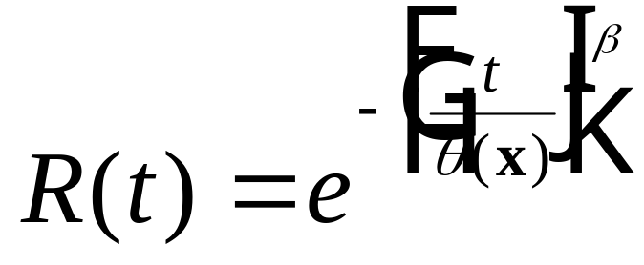
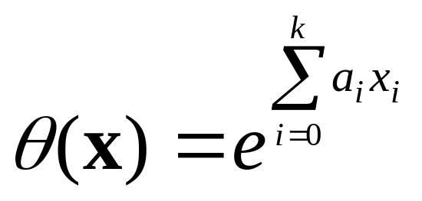
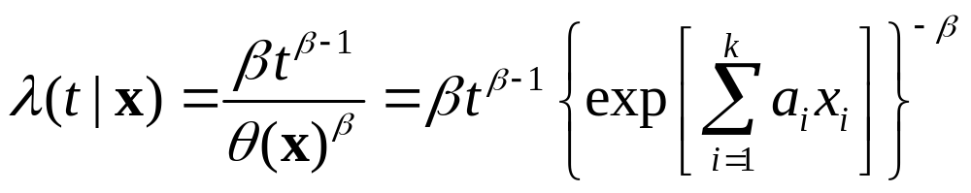
Weibull Case
and
Chapter 7
Notes:
The multiplicative model can be used to estimate the scale parameter of the Weibull distribution. An assumption is that the shape parameter does not depend upon the values of the covariates. Once the scale parameter is determine from the values of the covariates, the reliability and hazard rate functions will look the same as before.

Slide 13
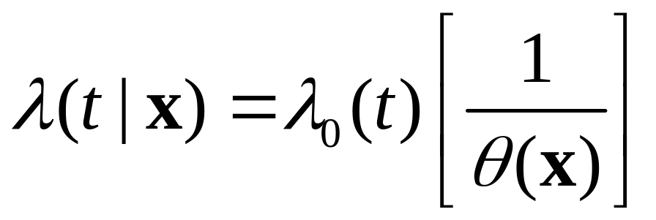
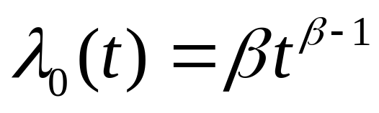
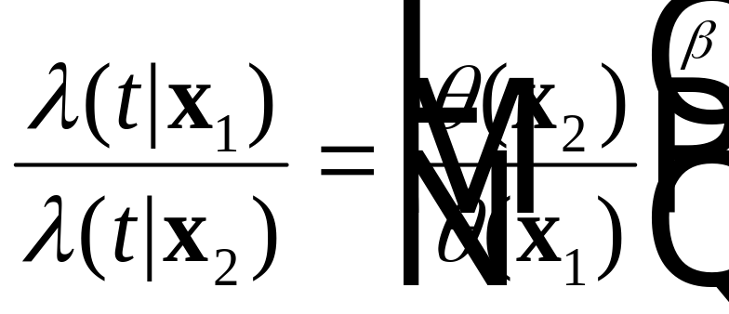
Proportional Hazard Rate
Chapter 7
Notes:
The ratio of two Weibull hazard rate functions is not a function of time but is only a function of the relative values of the scale parameters adjusted by beta.

Slide 14
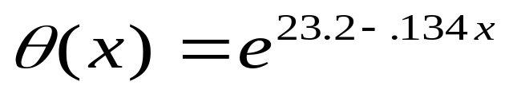
Weibull - Example
Time to failure of a motor is Weibull with a shape
parameter of 1.5 and
where x = load placed on a motor. Find the .95 design
life if a motor is to have a load of 115. What if the load
is reduced to 100?
Solution: θ(115) = 2416.3
and t_{.95} = 2416.3 ( - ln .95 )^{.6667} = 333.5 hr.
θ(100) = 18033.7
and t_{.95} = 18,033.7 ( - ln .95 )^{.6667} = 2489.3 hr.
Chapter 7
Notes:
This example is rather straight-forward.

Slide 15
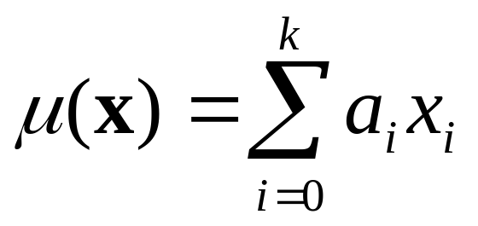
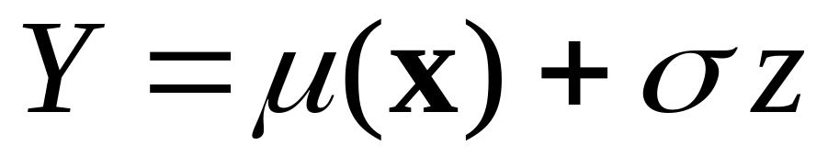
Location-Scale Models
where z has a specified probability distribution such as
the normal with zero mean and variance of 1. Therefore
Y is normal with mean u(x) and variance σ².
Chapter 7
Notes:
The normal location parameter (the mean) is represented as a linear function of the covariates.

Slide 16
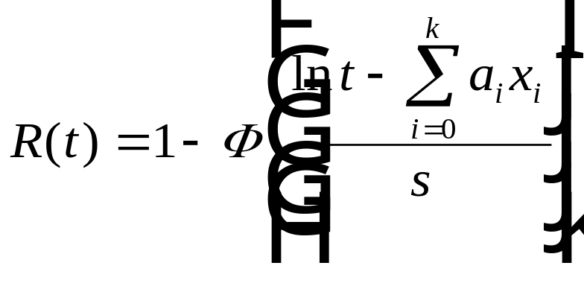
Lognormal Case
Set T = e^{Y} ; if T is lognormal, then Y is normal
with some mean u(x) and standard deviation s,
and
T is lognormal with shape parameter s and t_{med} = e^{u(x)}
Chapter 7
Notes:
The lognormal location parameter (the median) can be represented as a multiplicative function of the covariates. Therefore the logarithm of the median is linear in the covariates.

Slide 17
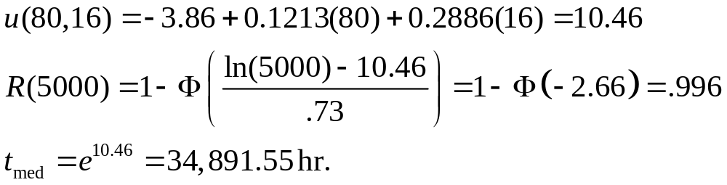
Example - Lognormal
Time to failure of electrical connector is lognormal with s = .73 and
u(x) = -3.86 + .1213x₁ + .2886x₂ where x₁ = operating temperature and x₂ = number of electrical contacts
A connector used in a PC will operate at 80⁰ C. and has 16 contact pins.
Chapter 7

Slide 18

Static Models
Stress versus Strength
Stress is any load which may produce a failure. A
failure occurs if the stress exceeds the strength. The
strength is the highest stress value that the system
can endure without failing.
Strength = f(material properties, design configuration or geometry, dimensions)
Case 1: Random Stress and Constant Strength
Case 2: Constant Stress and Random Strength
Case 3: Random Stress and Random Strength
Chapter 7
Notes:
An entirely different approach to modeling reliability is to compute the probability that a stress exceeds a strength resulting in a failure. Initially, it is assumed that a single stress is applied against some strength. Either a failure occurs or does not occur. However, if either the stress or strength (or both) are random, then there will some probability of a failure. The static reliability is one minus the probability of a failure. It is called static reliability since the reliability over time is not being considered here. The three cases shown will be discussed in turn.

Slide 19
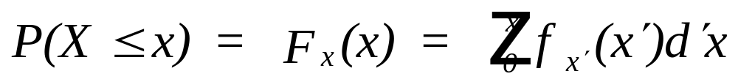
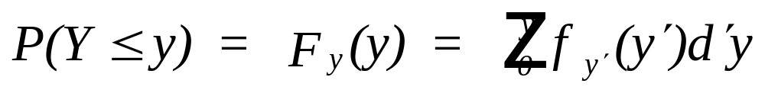
The Random Variables
Let X = a continuous random variable, the stress
placed on a system with
Y = a random variable, the strength (capacity)
of the system with
Chapter 7
Notes:
Defining both stress and strength as random variables leads to two probability distributions each having the PDF and CDF as represented above. It is important to recognize that the random variables are stress and strength and not time to failure.

Slide 20
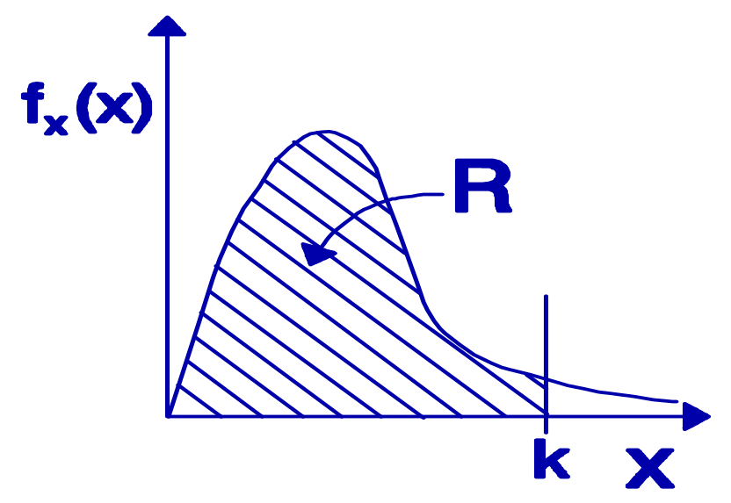
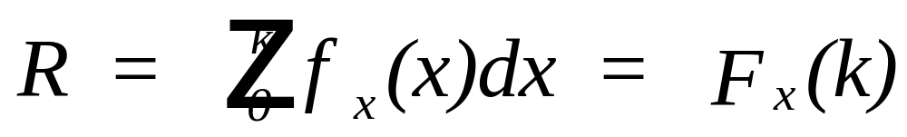
Case 1: Random Stress and Constant Strength
Chapter 7
Notes:
If the design strength of the component is assumed to be constant and known, then the component will fail when a stress occurs that exceeds the design strength. Therefore its reliability with respect to this stress is the probability that the stress, treated as random, does not exceed the design strength.

Slide 21

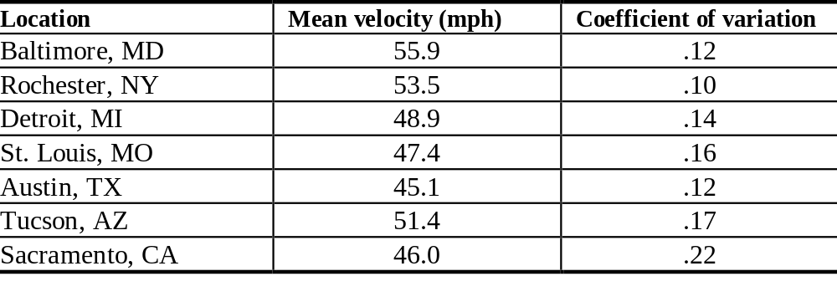
Case 1 Example
Wind velocity
Maximum Annual Value
Chapter 7
Notes:
Good examples of random stresses are forces occurring in nature such as high winds, tornados, floods, hurricanes, etc. Given the coefficient of variation and the mean, how would the standard deviation be found? Is it reasonable to assume that the maximum annual wind velocity is normally distributed?

Slide 22


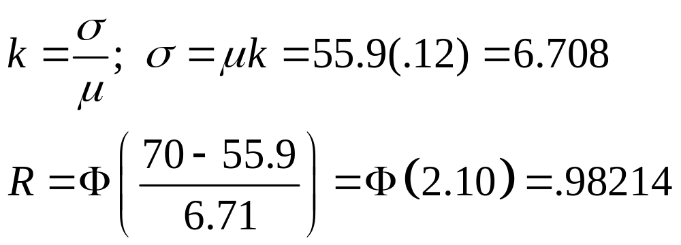
Case 1 Example
I designed this building to withstand winds up to 70 mph.
Baltimore: Mean = 55.9, k = .12
Assuming a normal distribution:
Chapter 7

Slide 23
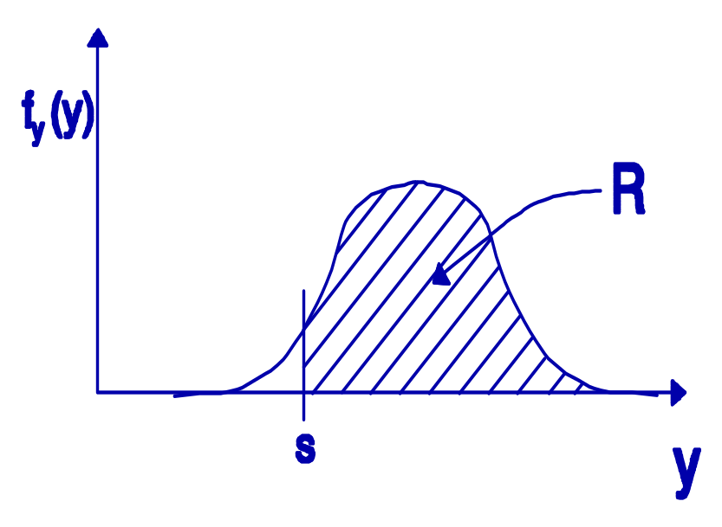
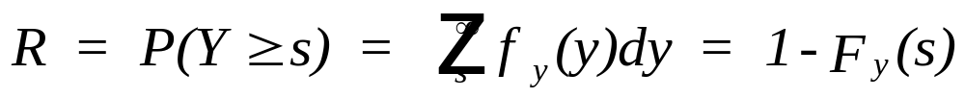
Case 2: Constant Stress and Random Strength
Chapter 7
Notes:
If the stress placed upon a component is assumed to be constant and known, then the component will fail when its design strength is less than the stress. Therefore its reliability with respect to this stress is the probability that the design strength, treated as random, exceeds the stress.

Slide 24
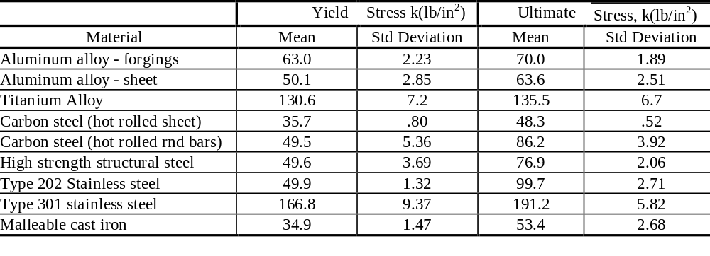
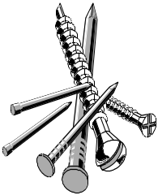

Case 2 Example
Material Properties
Chapter 7
Notes:
Choice of materials during product design can have a significant impact on the design strength. However, for a given material selection, the design strength will usually vary because of differing amount of impurities in the materials used and variations in the manufacturing process.

Slide 25

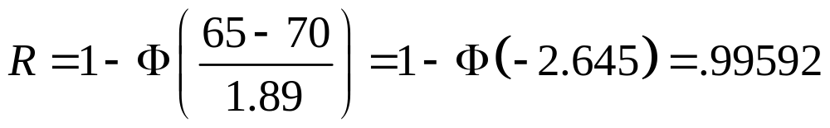
Example Case 2
Observe that I am applying a constant load of 65 pounds per square inch.
Load = s = 65 lb/in²
Assume normal:
Chapter 7

Slide 26
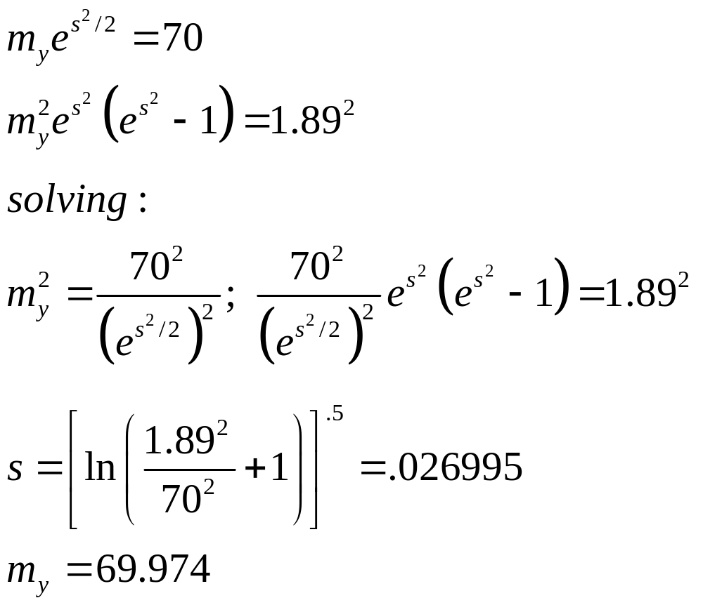

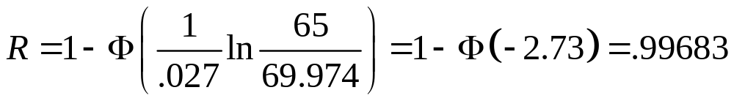
Case 2 Lognormal Example
Why must they all be normal?
Chapter 7

Slide 27
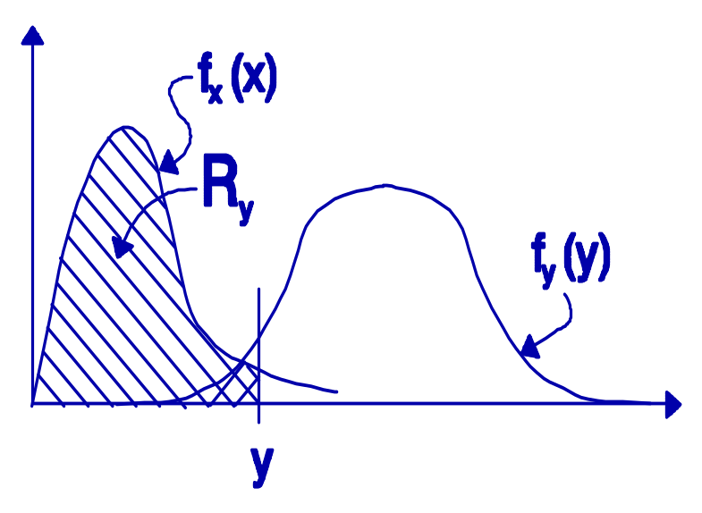
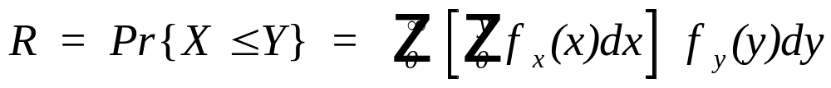
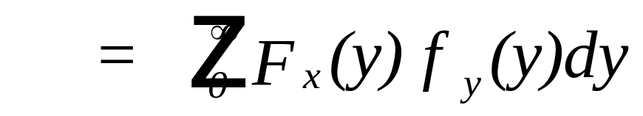
Case 3: Random Stress and Random Strength
Interference
Theory
Chapter 7
Notes:
If both stress and strength are assumed to be random variables, then failures still occur when the strength is less than the stress. This probability is found by analyzing the area where the tails of the two distributions overlap. This is often referred to as interference theory. Pay close attention to the limits of the two integrals. It is important that they be correctly determined.

Slide 28
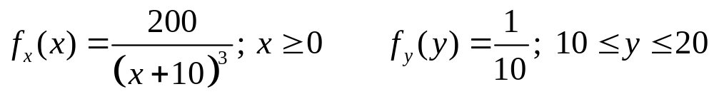
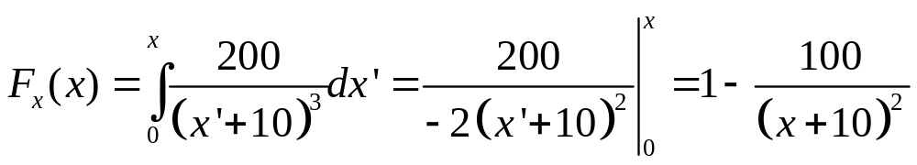
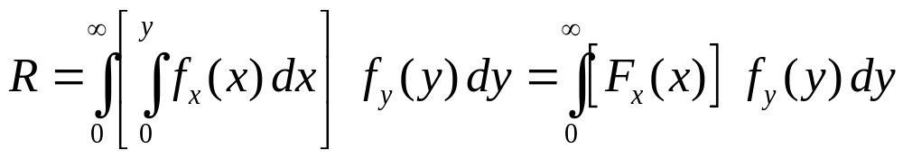
Case 3 Example - X & Y Random
Chapter 7

Slide 29
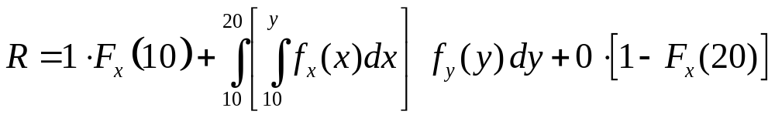
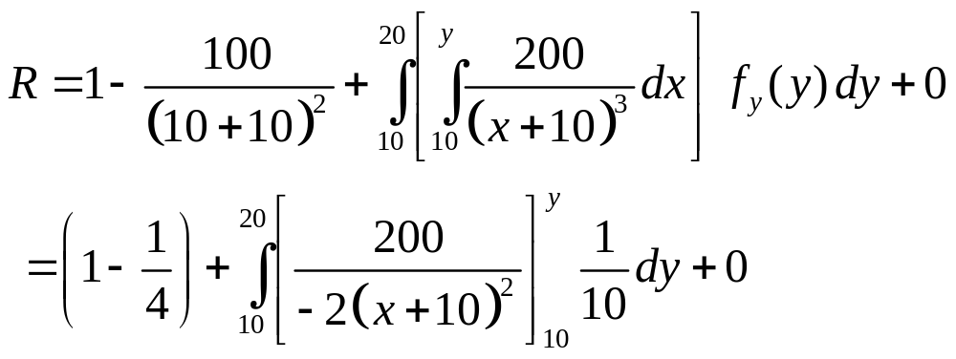
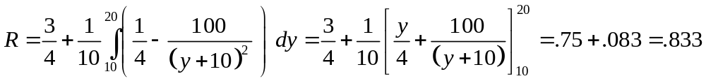
Continuing Case 3 Example
Chapter 7

Slide 30
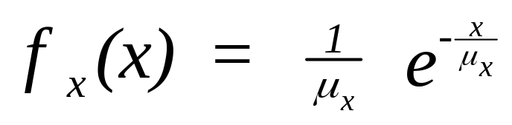
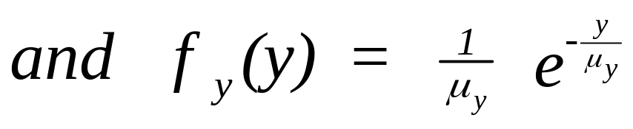
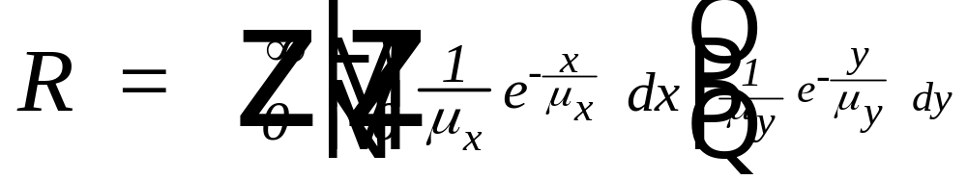


Exponential Case 3
Chapter 7
Notes:
If both stress and strength are exponential, the static reliability can be found by evaluating the double integral as shown.

Slide 31



Exponential Case 3 (continued)
Chapter 7
Notes:
The final result shows the static reliability as a function of the ratio of the mean stress to the mean strength.

Slide 32

Exponential Case 3
Chapter 7
Notes:
The static reliability is computed for certain values of the ratio of the mean stress to the mean strength. Traditional engineering would refer to the reciprocal of this ratio as the safety factor and would not consider this factor as a ratio of means. Therefore the static reliability would not be found and the problem would be treated as deterministic and not random. As shown here, a safety factor of 10 would only provide a .91 reliability.

Slide 33


Static Reliability -Normal Case
Let X = a normal stress with mean u_{x} and std deviation _{x}
and Y = a normal strength with mean u_{y} and std deviation _{y}.
Then R = P(Y >= X) = P(Y-X >= 0) = P(W >= 0)
where W = Y-X, E[W] = E[Y-X] = u_{y} - u_{x} and,
Var[W] = Var[Y-X] =
Y and X are independent
Chapter 7
Notes:
If both stress and strength are normal, the static reliability may be found using the fact that the difference of two normally distributed random variables is also normally distributed having the mean and variance as shown.

Slide 34


Static Reliability -Normal Case
Chapter 7
Notes:
If the difference between the strength minus the stress is positive, then the component will not fail. The probability can be found using the normal probability tables.

Slide 35
Static Reliability -Lognormal Case
X = a lognormal stress with median m_{x} and shape parameter s_{x}
Y = a lognormal strength with median m_{y} and shape parameter s_{y}.
Then R = P(Y >= X) = P(Y/X >= 1)
Let W = ln(Y/X) = ln Y - ln X, then W is normal with mean,
W = ln(m_{y}/m_{x}) and, Var[W] = s_{y}² + s_{x}² (Y and X are independent)
Chapter 7
Notes:
The lognormal case where both stress and strength are lognormal, can be treated similar to the previous normal case. Only now, we compute the probability that the ratio of the strength to the stress is greater than one (1). By taking the natural logarithms, the problem is converted into the difference between two normally distributed random variables.

Slide 36


Static Reliability -Lognormal Case
Chapter 7
Notes:
The static reliability for the lognormal case, can be found using the normal probability tables.

Slide 37











Summary - Static Reliability and the Theoretical Distributions
Constant Constant Random Stress
Distribution Strength k Stress s and strength
Exponential
Weibull
Normal
Lognormal
solve numerically
Chapter 7
Notes:
The above table summarizes for the four distributions shown the formulae for computing the static reliability. Unfortunately, if both stress and strength are Weibull, then the double integral cannot be solved in closed-form. Do you see how the constant strength and constant stress cases are derived?

Slide 38




Mixed distributions:
Exponential stress and gamma strength
Gamma stress and exponential strength see Exercise 7.41
Chapter 7

Slide 39

Example 7.12
The stress placed on a manufactured part has been measured in a lab to be exponentially distributed with a mean of 20 psi. Because of impurities in the manufacturing process, the strength of the part has been found to have a gamma distribution with a scale parameter of 70 psi and a shape parameter of 3.4. Therefore,
Chapter 7

Slide 40


Bonus Case 3 (no extra charge)
Normal strength and exponential stress
exponential strength and normal stress
Reference: Kapur & Lamberson, Reliability in Engineering Design, Wiley 1977
Chapter 7

Slide 41


Example of the bonus case
Chapter 7

Slide 42
Summary
Covariate Models
Static Models
  Case 1 random stress
  Case 2 ransom strength
  Case 3 random stress and strength
Coming soon in Chapter 7
Dynamic Models
Physics of Failure Models
Chapter 7
Notes:
You should now work the assigned Chapter 7 problems if you have not already done so.

